Slide 1
Konstruksi Tesaurus DAN TAJUK SUBJEK
DIKUTP DARI University of California, Berkeley
School of Information IS 245: Organization of Information In Collections
AND LCSH

Slide 2
Hierarchical Classification
Literature
English
French
Spanish
...
...
Prose
Poetry
Drama
...
Prose
Poetry
Drama
...
...
16th
17th
18th
19th
16th
17th
18th
19th

Slide 3
Facetted Classification Along With Labeled Categories
A Language
a English
b French
c Spanish
B Genre
a Prose
b Poetry
c Drama
C Period
a 16th Century
b 17th Century
c 18th Century
d 19th Century
Aa English Literature
AaBa English Prose
AaBaCa English Prose 16th Century
AbBbCd French Poetry 19th Century
BbCd Drama 19th Century

Slide 4
Ranganathan
PMEST Facets
P(ersonality)
WHO: The most important types or names of things for the particular discipline
M(atter)
WHAT: Constituent materials
E(nergy)
HOW: Action or activity terms
S(pace)
WHERE: Where things occur
T(ime)
WHEN: When things occur

Slide 5
“Classical” Facet Analysis
What is being done?
Entity
Kind
Product
By-Product
What are its parts?
Part
What are its properties?
Property
Material
How is this achieved?
Process
By what means?
Operation
By whom?
Agent
Patient
Where?
Space
When?
Time

Slide 6
“Classical” Facet Analysis
Nouns
Entity
Kind
Part
Patient
Product
By-Product
Agent
Adjectives
Property
Material
Intransitive Verb
Process
Transitive Verb
Operation
Adverb
Space
Time

Slide 7
Semantic and Syntactic Relationships
Semantic relationships
Is-A (thing/kind, genus/species)
Mammals
Primates
Humans
Has-Parts
Human
Head
Eyes
Syntactic relationships
Compounds
Wheat + harvesting = “wheat harvesting”
Object + operation = operation on object

Slide 8
Facetted Classification
Clearly distinguishes between semantic relationships and syntactic relationships
Semantic relationships
Within a facet
Containment relations
Syntactic relationships
Across facets
Combinatoric relations
Have a “syntax” for syntactic combination of semantic terms

Slide 9
Power of Facet Combinations
The syntactic relations of facetted classifications enable a small controlled vocabulary to produce
Many, many structured descriptions
Complex, but formally structured descriptions using nested compound descriptions
Descriptions for things we do not have words for

Slide 10
Types of Indexing Languages
Uncontrolled keyword indexing
Indexing languages
Controlled, but not structured
Thesauri
Controlled and structured
Classification systems
Controlled, structured, and coded
Facetted classification systems

Slide 11
Examples
Non-Facetted
The ERIC Thesaurus of Descriptors
Semi-Facetted
The Medical Subject Headings (MESH) of the National Library of Medicine
Facetted
The Art and Architecture Thesaurus

Slide 18
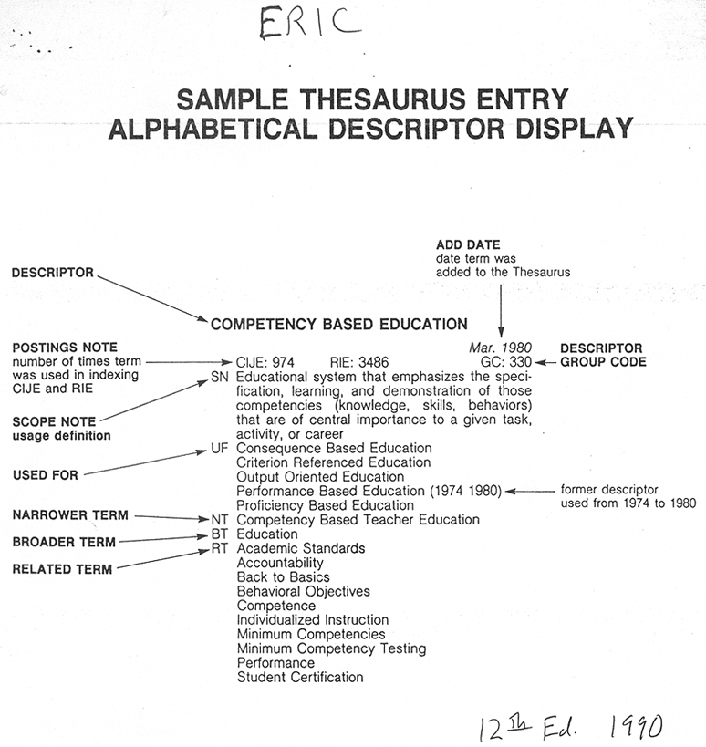
ERIC Thesaurus – Entry

Slide 19
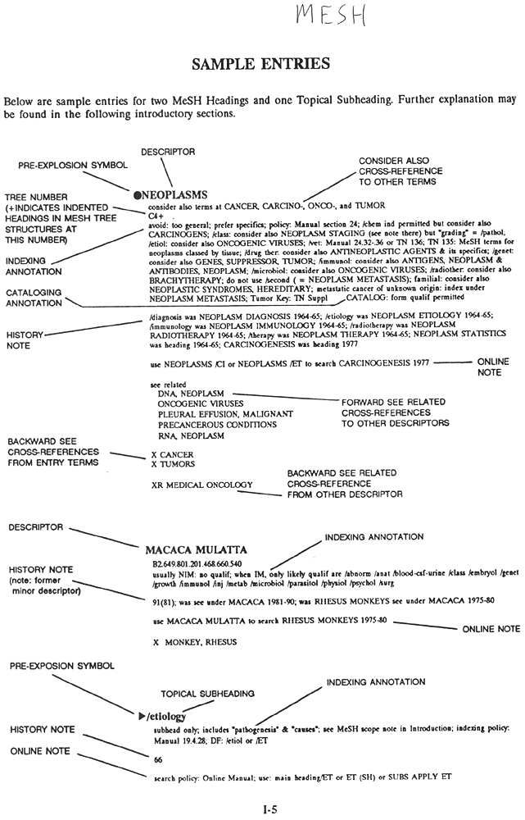
MESH – Entry

